Slide 1
Derivative?
City university of New York – Baruch college
Wonseok Jung

Slide 2
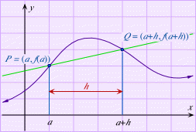















Secant Line?
Calculus 10e – Ron Larson, Bruce Edwards

Slide 3
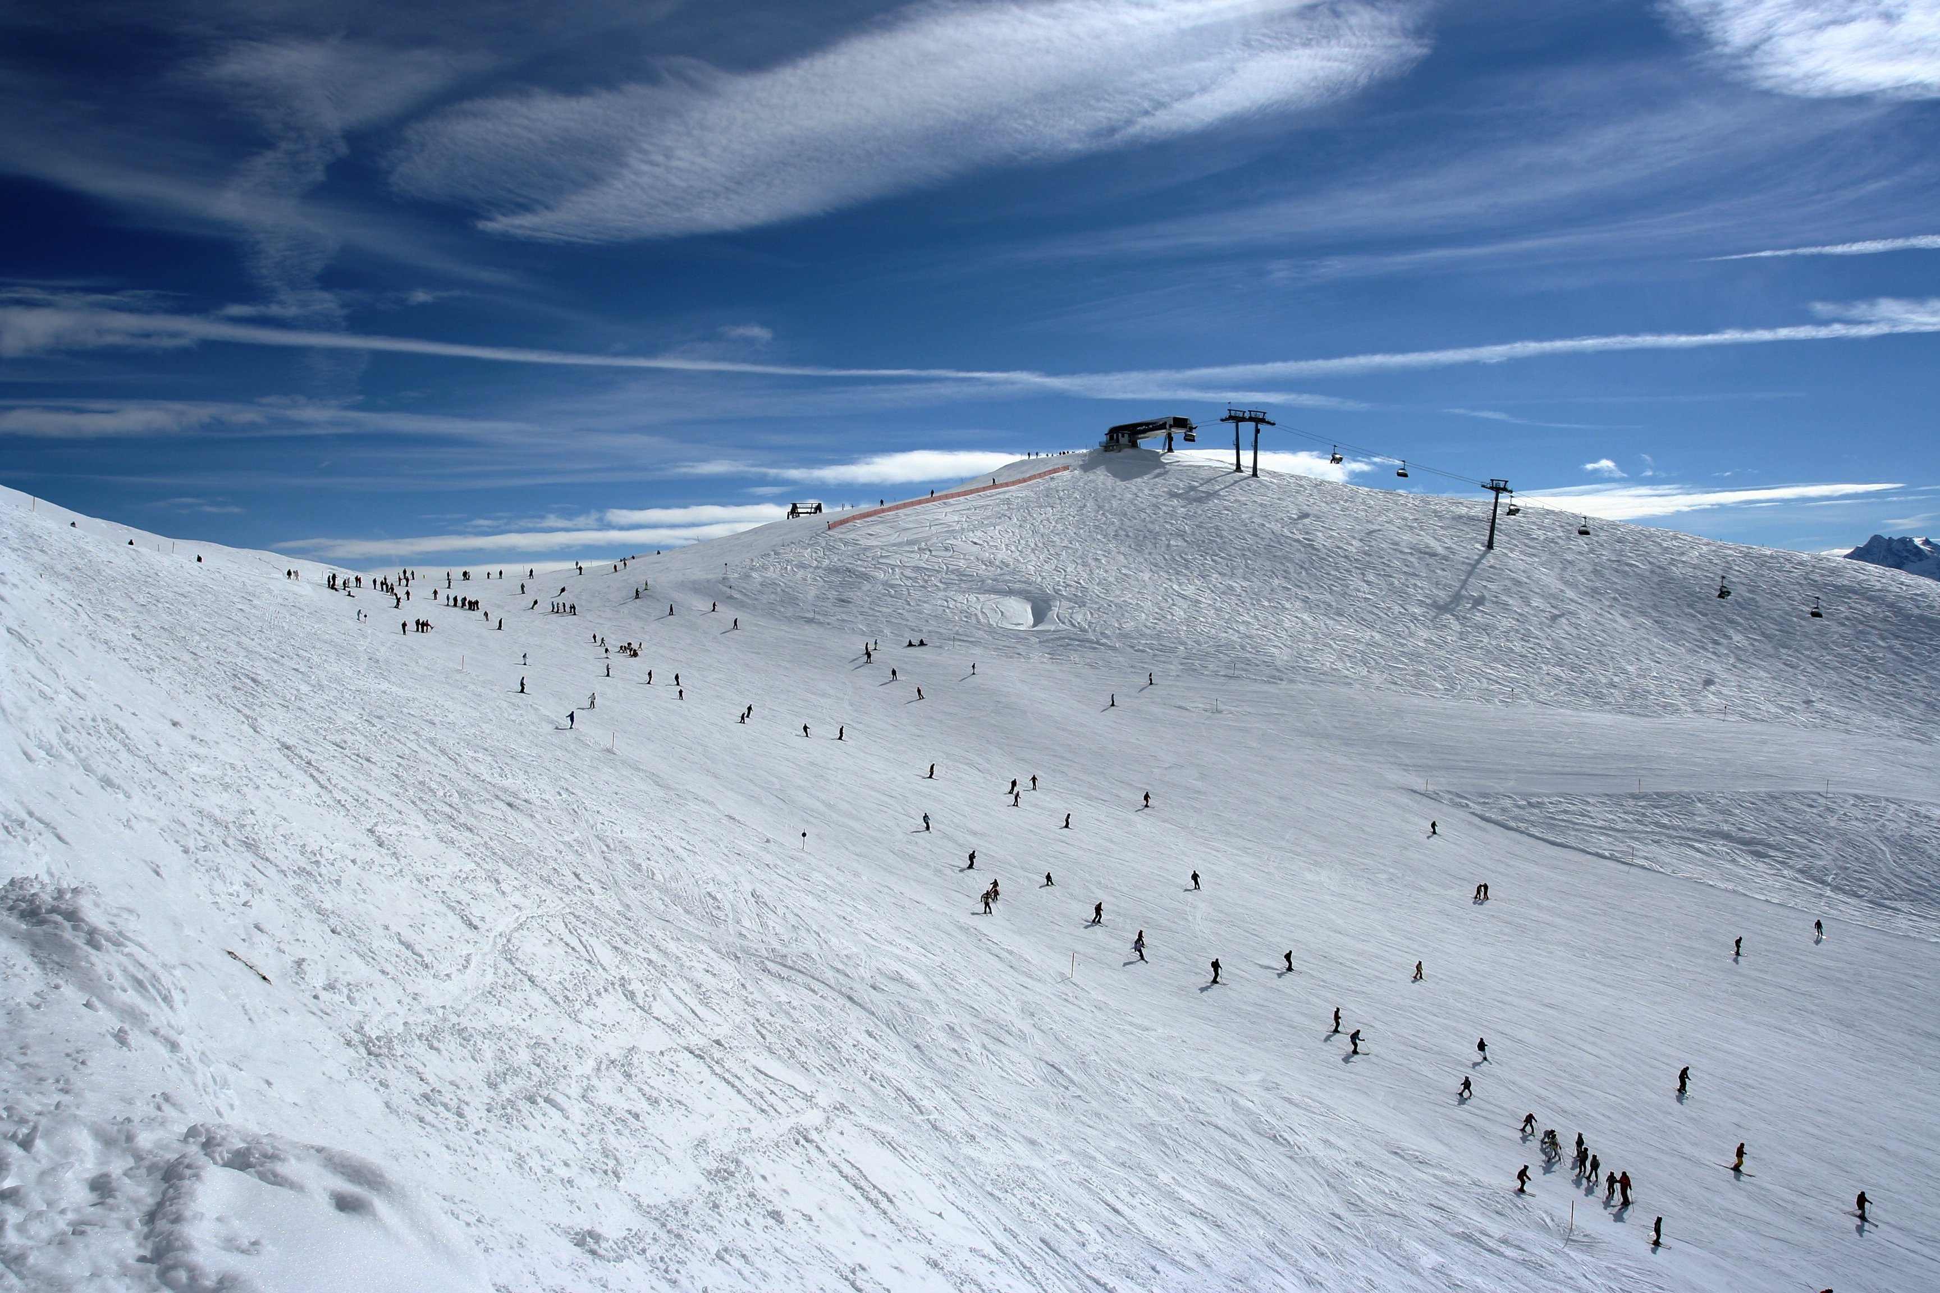
Slope!?

Slide 4

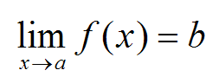
Limit!

Slide 5

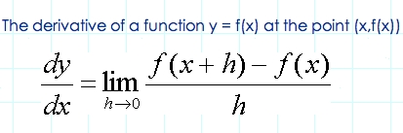


Derivative!
The limit used to define the slope of a tangent line is also used to define one of the two fundamental of calculus- differentiation
Calculus 10e

Slide 6



Examples

